Slide 1
DISCOVERING
PETERLOO

Slide 2
WHEN?

Slide 3
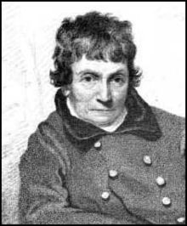
MAJOR JOHN CARTWRIGHT
FOUNDER OF THE FIRST HAMPDEN CLUB

Slide 4
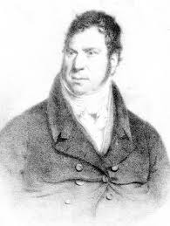
JOSEPH NADIN
DEPUTY CHIEF CONSTABLE
OF MANCHESTER

Slide 5
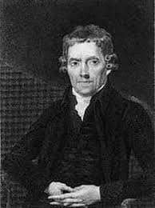
JOSEPH JOHNSON
BRUSHMAKER

Slide 6
JOSEPH JOHNSON
BRUSHMAKER
FOUNDER MEMBER OF PATRIOTIC UNION SOCIETY

Slide 7
JOSEPH JOHNSON
BRUSHMAKER
FOUNDER MEMBER OF PATRIOTIC UNION SOCIETY
CO-FOUNDER OF MANCHESTER OBSERVER NEWSPAPER

Slide 8
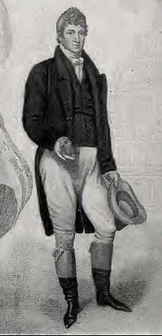
HENRY HUNT
THE GREATEST ORATOR OF HIS TIME

Slide 9
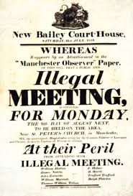

Slide 10
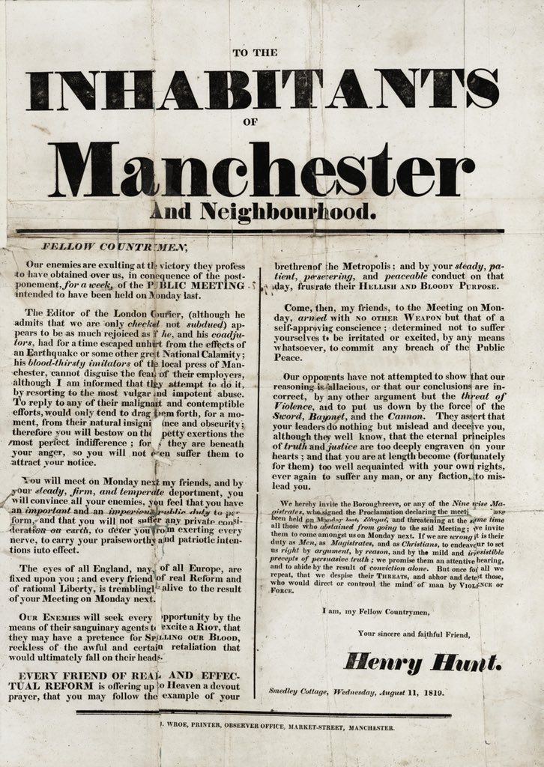

Slide 12
WHAT?

Slide 13
The stated purpose of the meeting meeting was
‘to take into consideration, the most speedy and effectual mode of obtaining Radical Reform in the House of Commons’

Slide 14
WHERE?

Slide 15
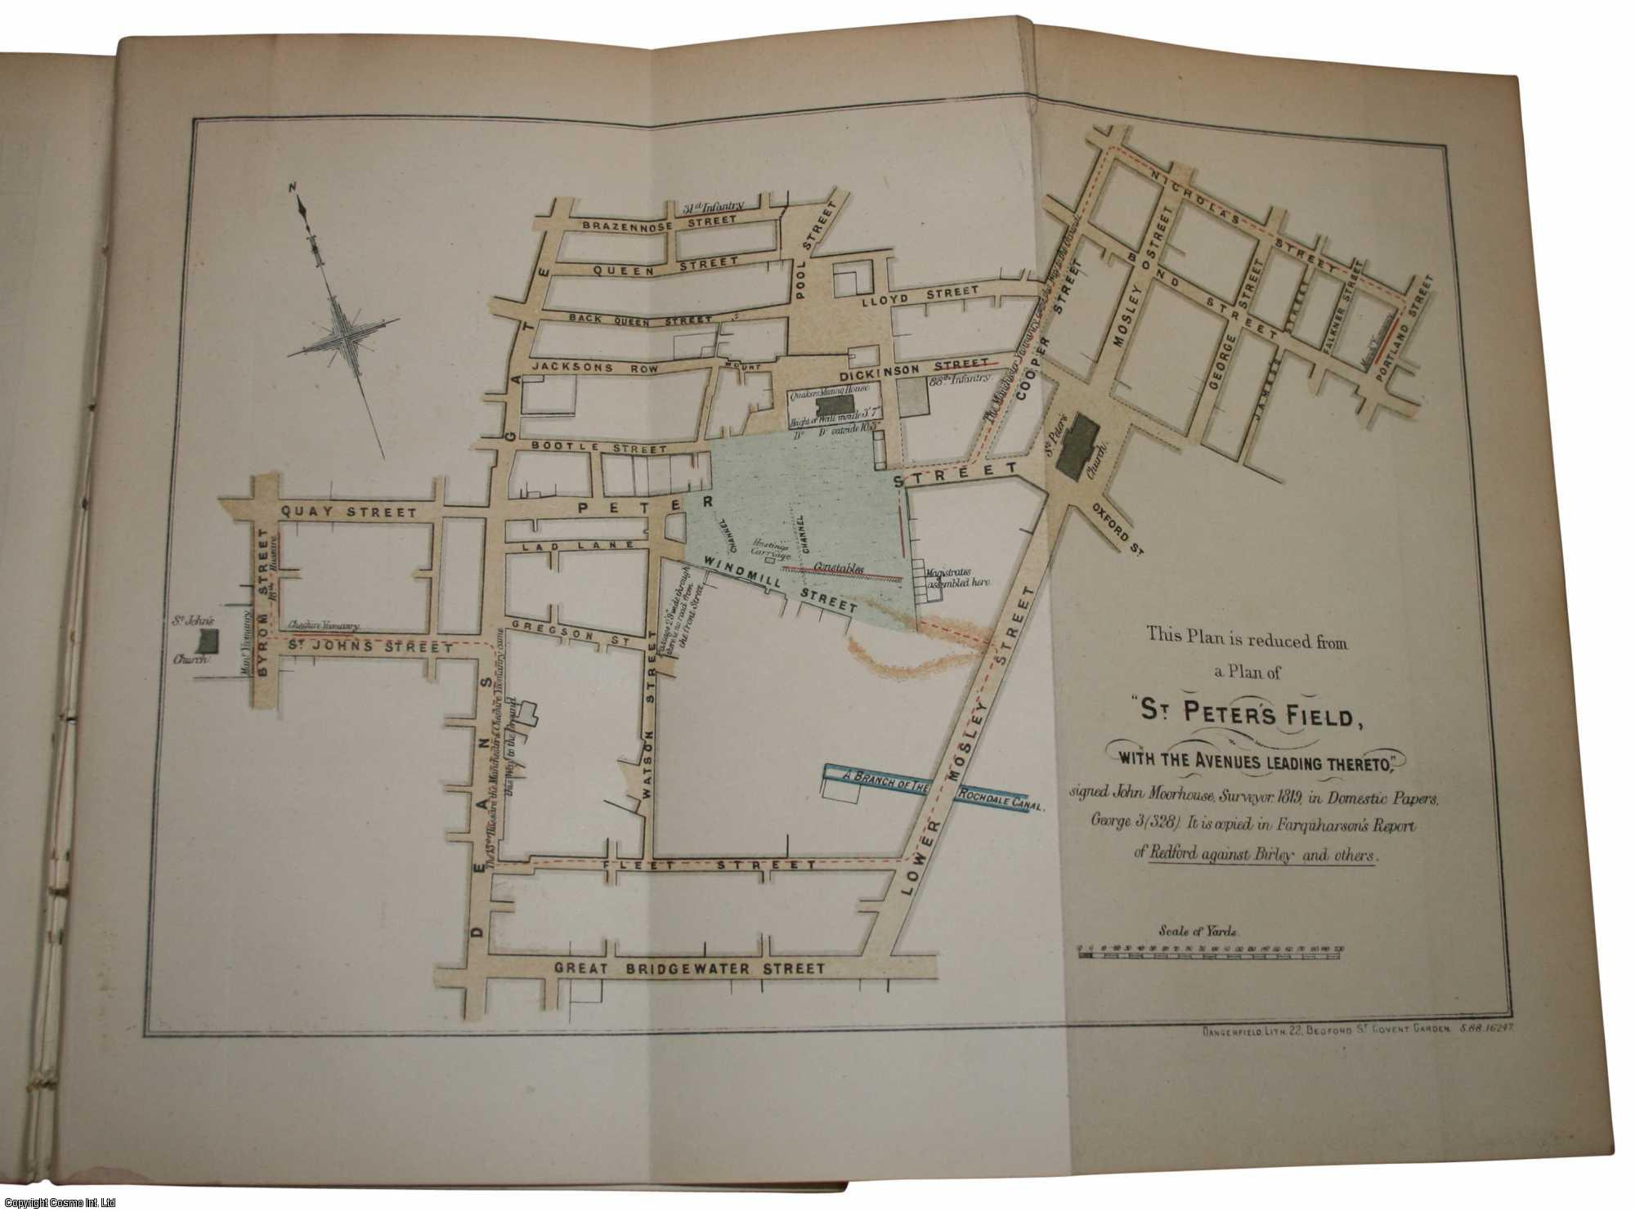

Slide 18
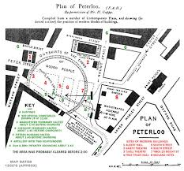

Slide 19
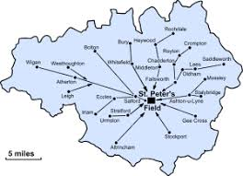

Slide 20
WHY?

Slide 21
THE FRENCH REVOLUTION

Slide 22
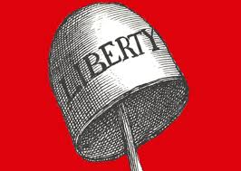
SUPPOSED ‘PROVOCATION’ OF THE AUTHORITIES

Slide 23
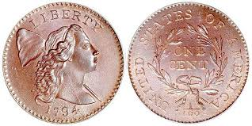
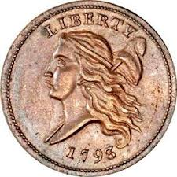
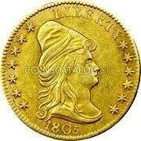

Slide 24
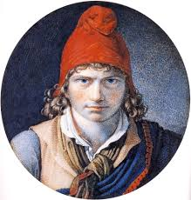

Slide 25
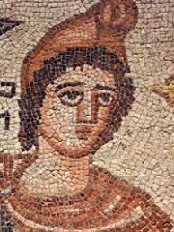

Slide 26
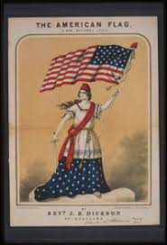

Slide 27
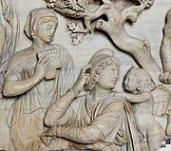

Slide 31
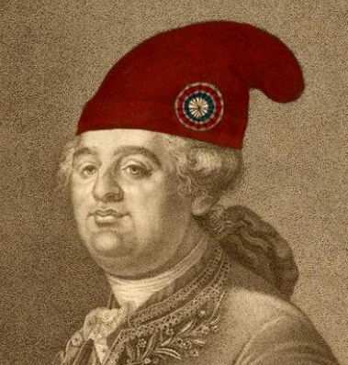
In this print, Louis XVI is made to wear a bonnet rouge, the blood-red cap of liberty, associated with the French revolution.

Slide 32
In this print, Louis XVI is made to wear a bonnet rouge, the blood-red cap of liberty, associated with the French revolution.
By simply altering a conventional print, the king is sharply mocked: the cap fits!

Slide 33
In this print, Louis XVI is made to wear a bonnet rouge, the blood-red cap of liberty, associated with the French revolution.
By simply altering a conventional print, the king is sharply mocked: the cap fits!

Slide 34
In this print, Louis XVI is made to wear a bonnet rouge, the blood-red cap of liberty, associated with the French revolution.
By simply altering a conventional print, the king is sharply mocked: the cap fits!
The image refers to the king’s public humiliation by a mob, which had broken into his residence, forced him to wear the cap and toasted the health of the revolution. Seven months later, he was executed.

Slide 35
WHAT?

Slide 36
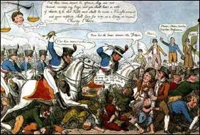

Slide 37
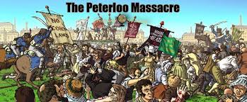

Slide 39
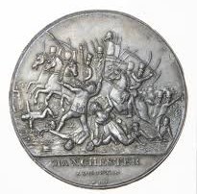
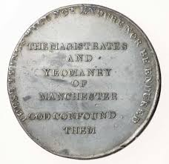
PETERLOO MEDAL
THE MAGISTRATES
AND
YEOMANRY
OF
MANCHESTER
GOD CONFOUND
THEM
THESE THINGS WILL NOT ENDURE NOR BE ENDURED

Slide 40
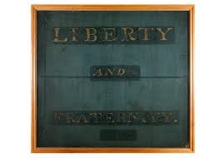

Slide 41
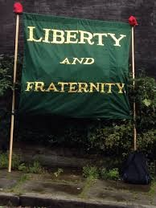

Slide 42
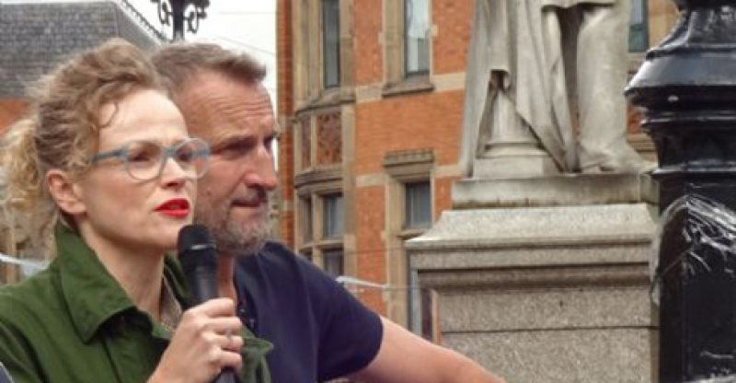

Slide 43
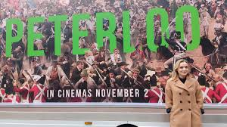

Slide 44
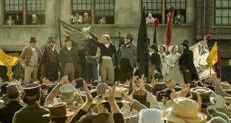

Slide 45
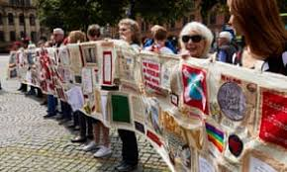

Slide 47
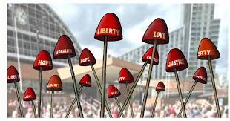
2019
PROVOCATION OF THE AUTHORITIES?

Slide 49
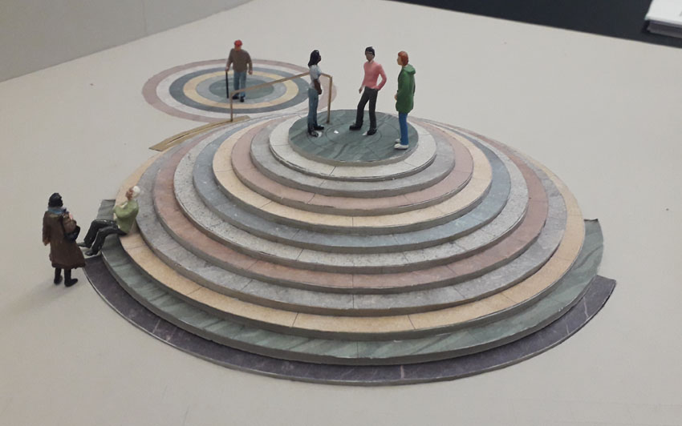

Slide 51
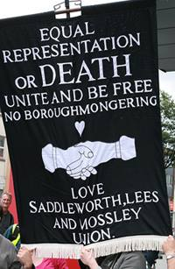

Slide 53
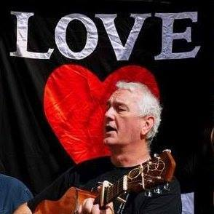

Slide 54
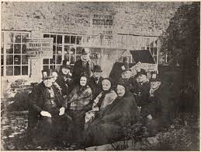
PETERLOO VETERANS SEPTEMBER 27th 1884
David Hilton (79)
Thomas Chadderton (81), John Davies (78), Thomas Ogden (81), Jonathan Dawson (82).
Susannah Whittaker (81), Mary Collins (83), Catherine McMurdo (88), Richard Waters.
Front: Thomas Schofield (81) Alice Schofield (79)

Slide 55
WHAT IF….?

