Slide 1
The Middleton Pace Egg Play

Slide 2
The Middleton Pace Egg Play(ish)

Slide 3
A huge crowd had gathered to witness the annual play

Slide 4
A huge crowd had gathered to witness the annual play
The people waited patiently for the play to start

Slide 5
Parents and children stood around, carefully respecting social distancing

Slide 6
Parents and children stood around, carefully respecting social distancing
The play was about to start

Slide 7
The players circled around singing their entrance song

Slide 8
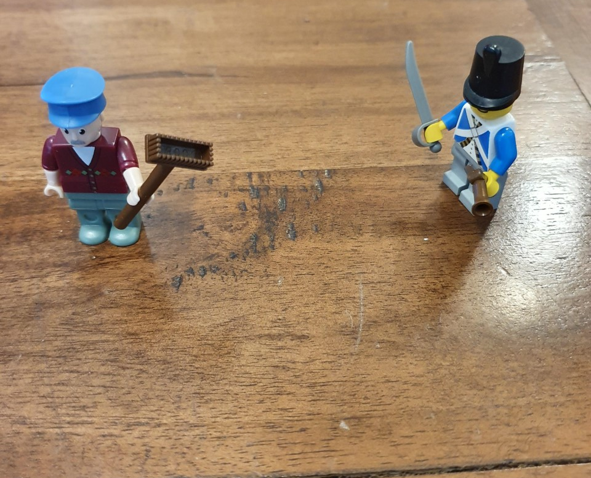
The players circled around singing their entrance song
Slowly, and with lots of space between them

Slide 9
The players circled around singing their entrance song
Slowly, and with lots of space between them

Slide 10
The players circled around singing their entrance song
Slowly, and with lots of space between them

Slide 11
The players circled around
And EVERYONE joined in the singing

Slide 12
EVERYONE joined in
And the singing was very good

Slide 13
Eventually all the players had assembled

Slide 14
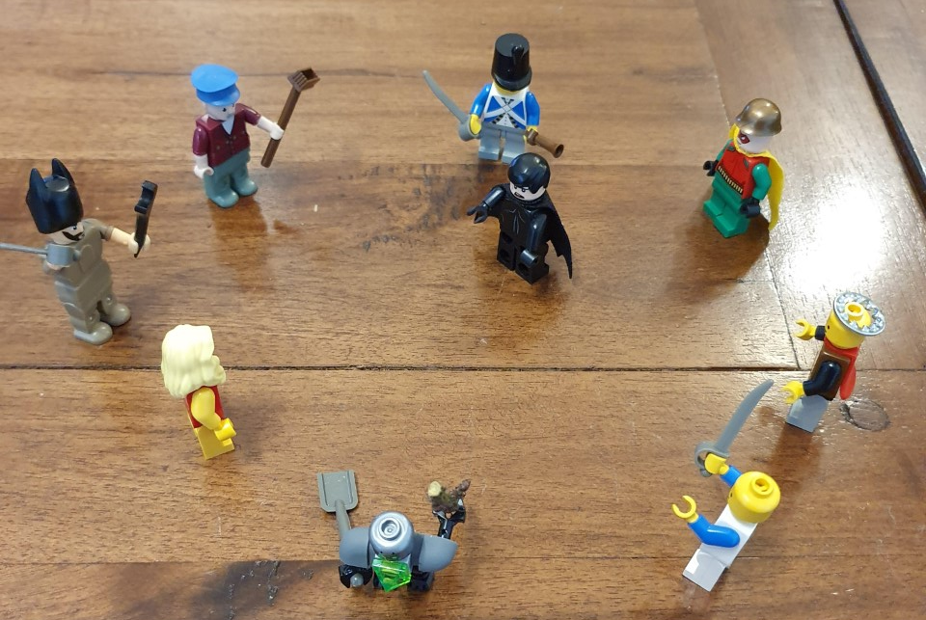
Eventually all the players had assembled
It was time for the play to start

Slide 15
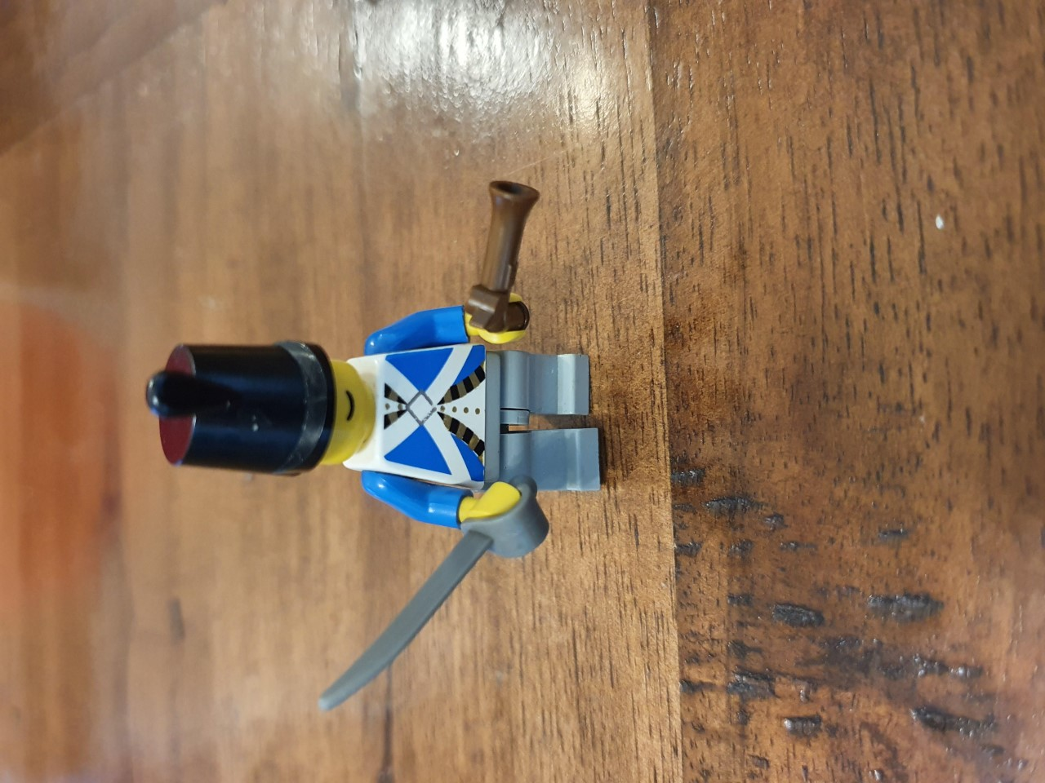
We beg your pardon for being so bold, We’ve come to your house cos the weather’s so cold

Slide 16
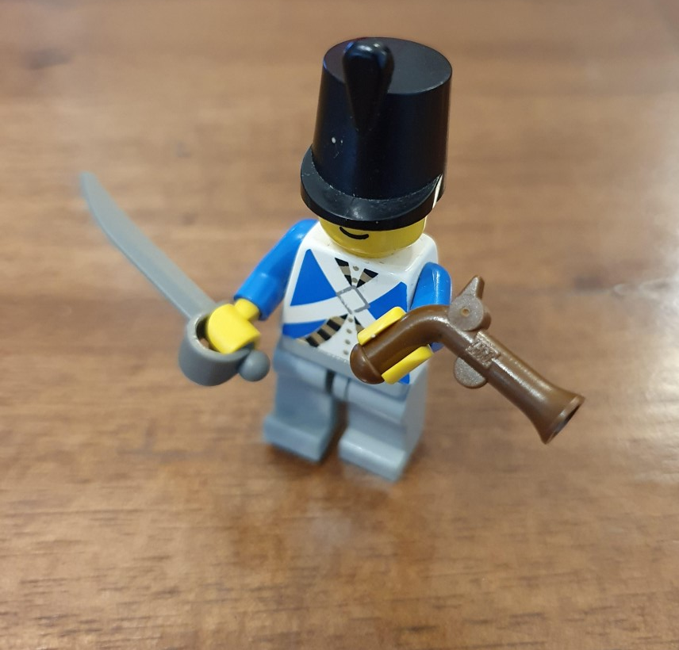
We beg your pardon for being so bold, We’ve entered your house cos the weather’s so cold
Room, room, brave gallants, give us room to sport,
For in this house we do resort.

Slide 17
We beg your pardon for being so bold, We’ve entered your house cos the weather’s so cold
Room, room, brave gallants, give us room to sport,
For in this house we do resort.
Resort! Resort, for many’s the day.
Step in the King of England and boldly clear the way

Slide 18
I am the King of England, that baldy doth appear

Slide 19
I am the King of England, that baldy doth appear
I come to seek my only son
My only son is here!

Slide 20
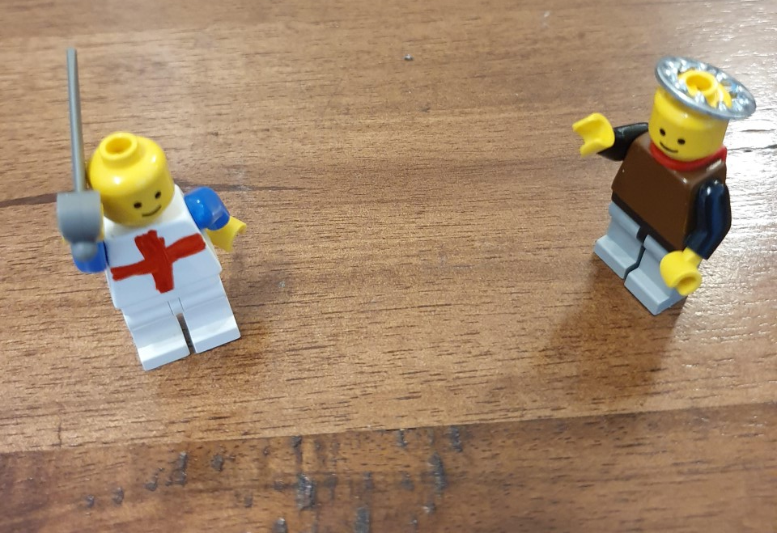
I am the King of England, that baldy doth appear
I come to seek my only son
My only son is here!

Slide 21
I am Saint George a worthy knight

Slide 22
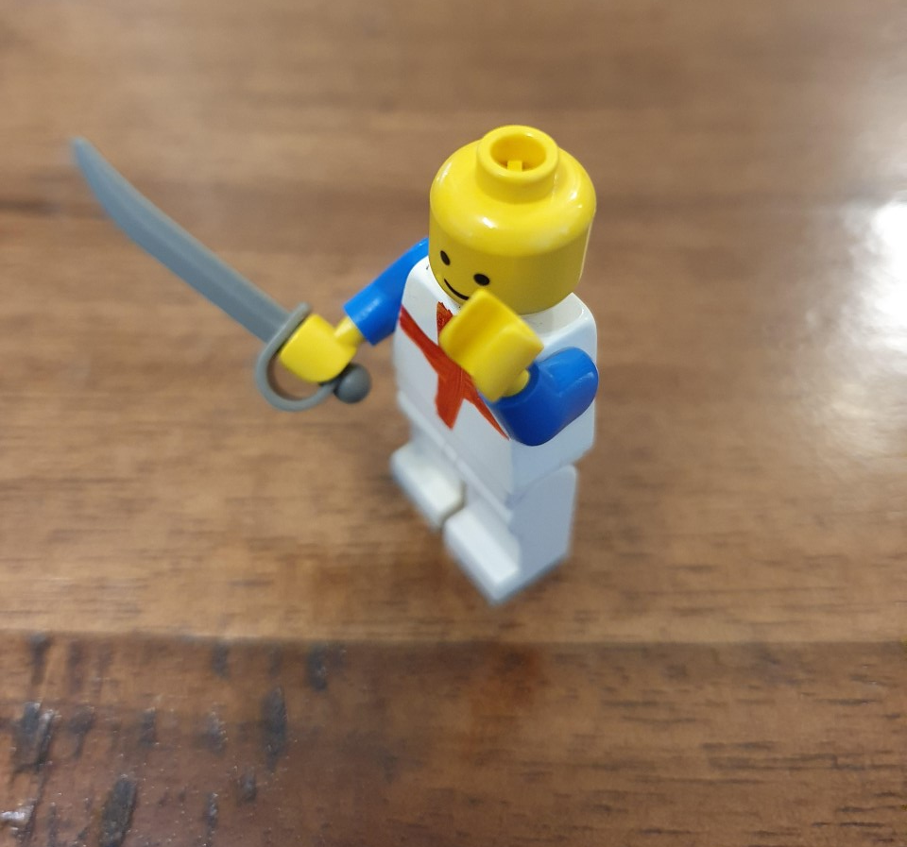
I am Saint George a worthy knight I’ll spend my blood for England’s right

Slide 23
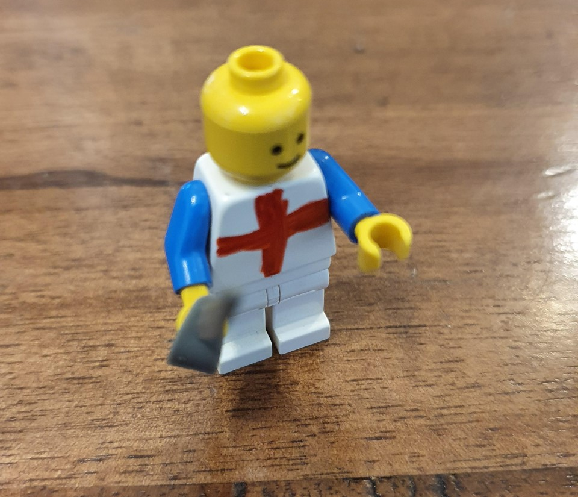
I am Saint George a worthy knight I’ll spend my blood for England’s right
England’s right I will maintain

Slide 24
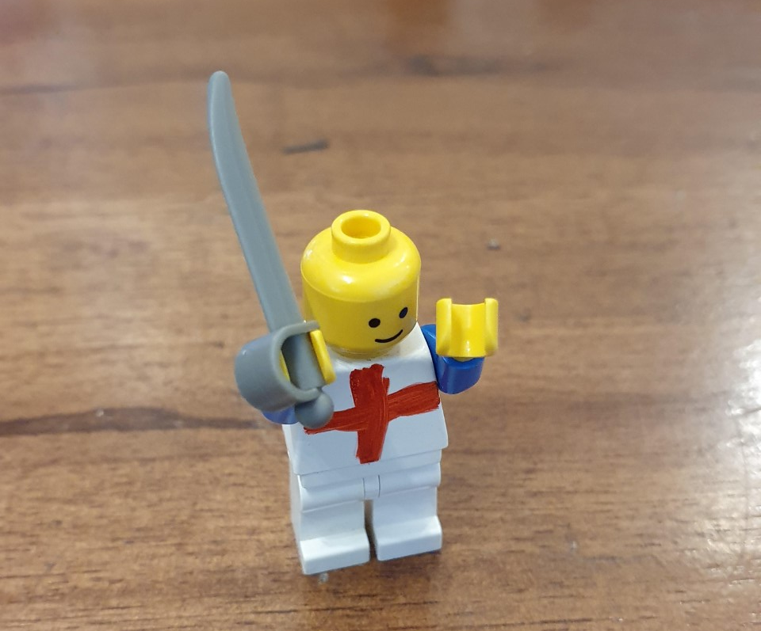
I am Saint George a worthy knight I’ll spend my blood for England’s right
England’s right I will maintain
I’ll fight for old England again and again!

Slide 25
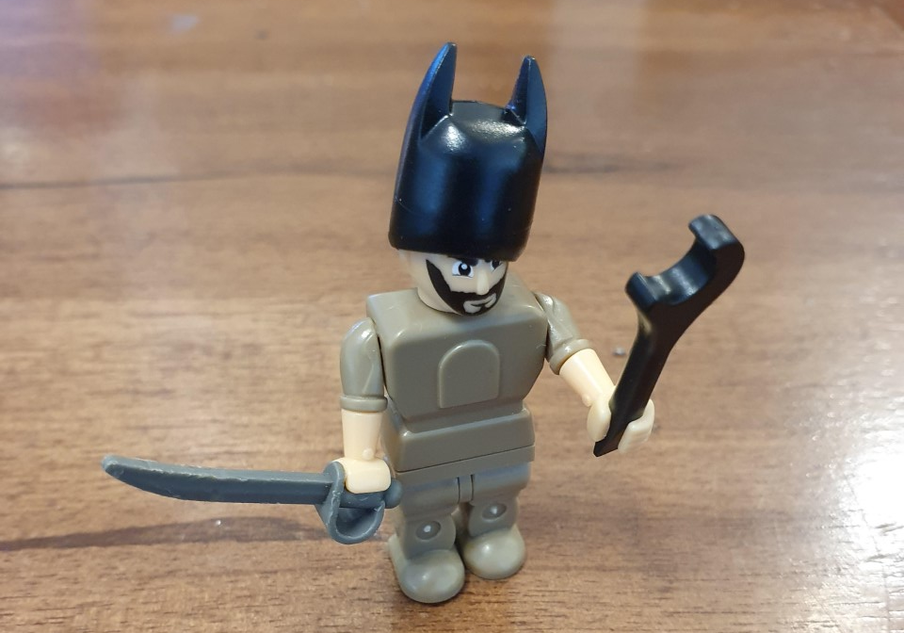
I am the Turkish Champion, from Turkey’s land I come

Slide 26
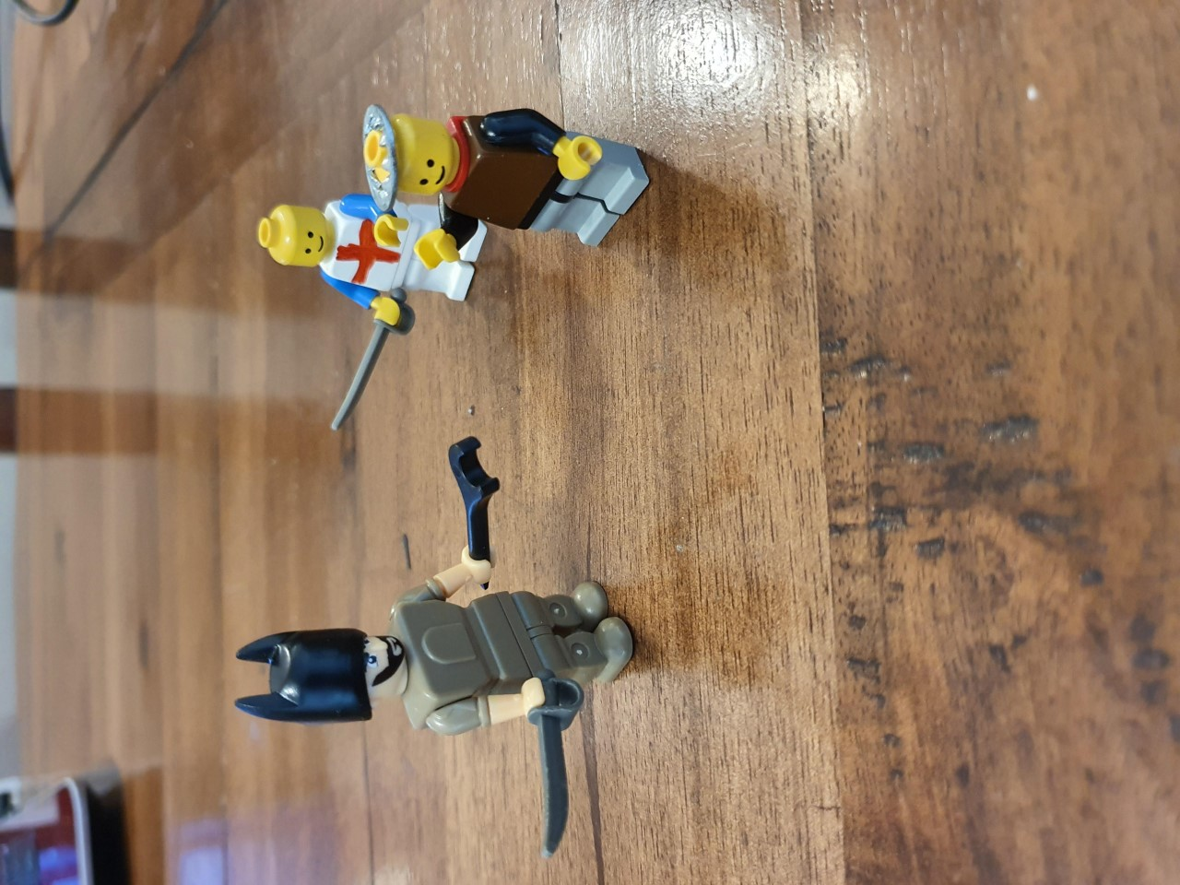
I am the Turkish Champion, from Turkey’s land I come
I come to fight the King of England,
And all his noble men

Slide 27
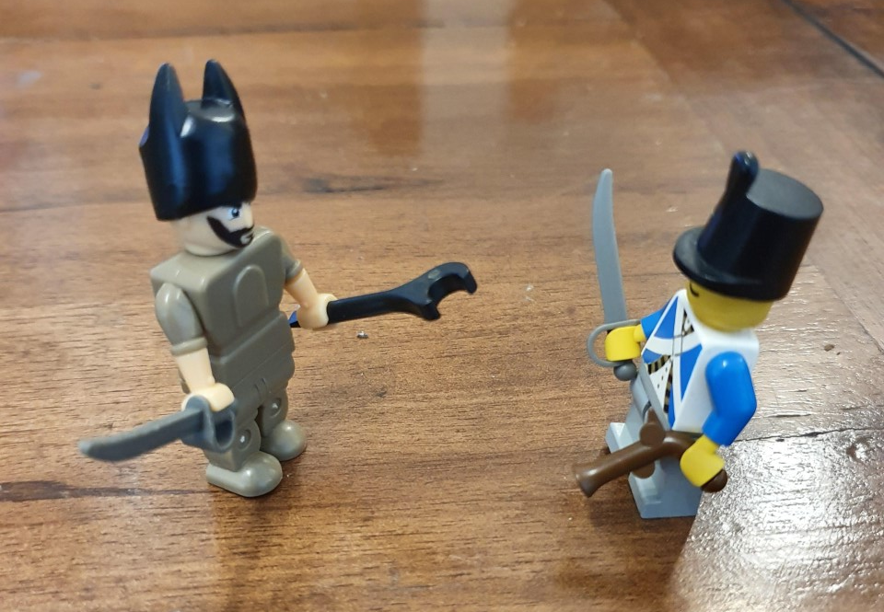
In comes Captain Slasher, Slasher is my name

Slide 28
In comes Captain Slasher, Slasher is my name
With sword and pistol by my side
I hope to win the game

Slide 29
They fight!

Slide 30
They fight!
Slasher is slain!!

Slide 31
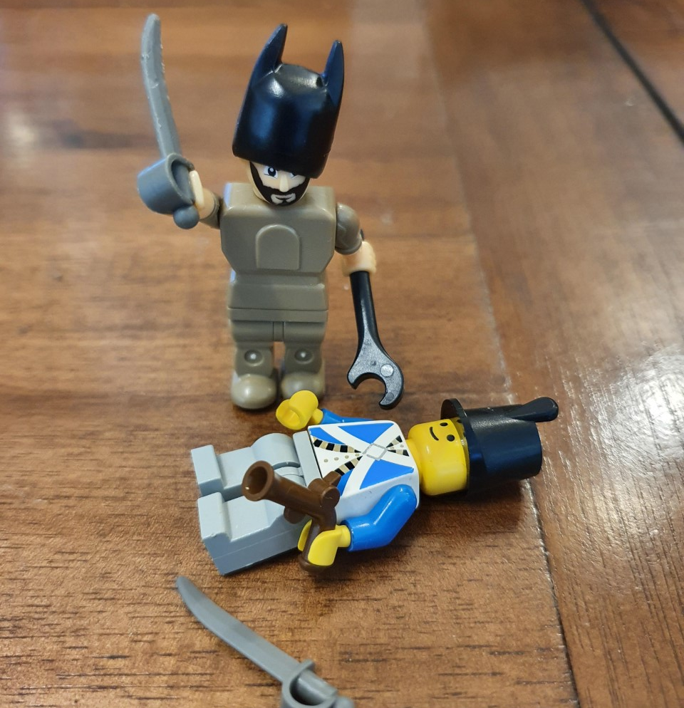

Slide 32
I am St George a champion bold

Slide 33
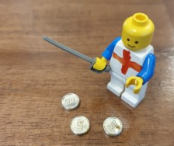
I am St George a champion bold And with my sword I won three crowns of gold

Slide 34
I am St George a champion bold And with my sword I won three crowns of gold
I slew the fiery dragon

Slide 35
I am St George a champion bold And with my sword I won three crowns of gold
I slew the fiery dragon, and brought him to the slaughter,

Slide 36
I am St George a champion bold And with my sword I won three crowns of gold
I slew the fiery dragon, and brought him to the slaughter,
And with my sword I won the King of Egypt’s only daughter

Slide 37
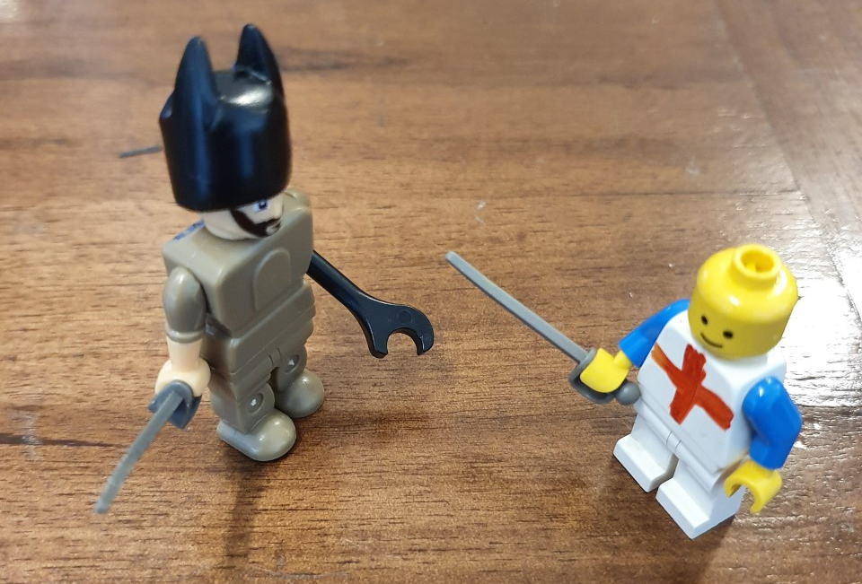
St George

Slide 38
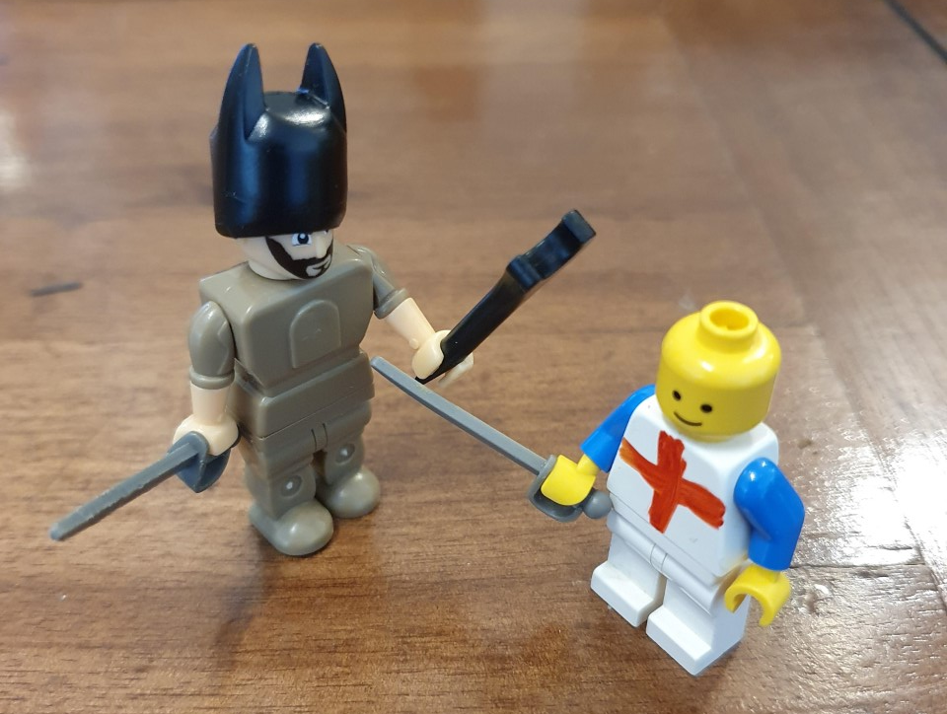
St George St George?!
As I was going by St George’s school
I heard a lady cry A fool! A fool!

Slide 39
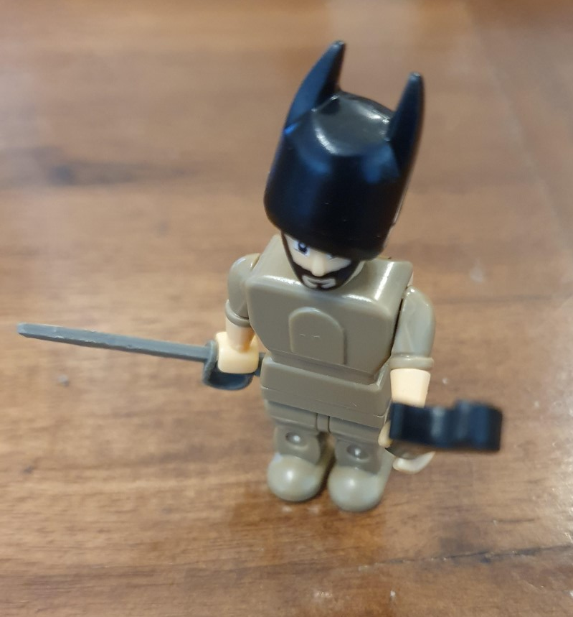
St George St George?!
As I was going by St George’s school
I heard a lady cry A fool! A fool!
A fool, a fool was her every word

Slide 40
The man’s a fool, He fights with a wooden sword!!

Slide 41
A wooden sword? You dirty dog

Slide 42
A wooden sword? You dirty dog
My sword is made of the best metal free

Slide 43
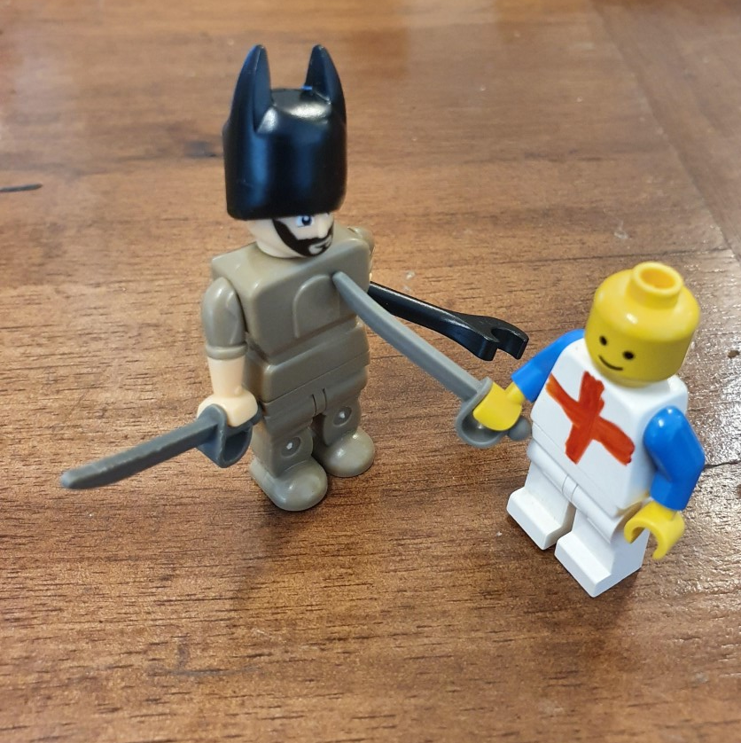
A wooden sword? You dirty dog
My sword is made of the best metal free
And if you want a taste of it
I’ll give it unto thee!!!

Slide 44
They fight!

Slide 45
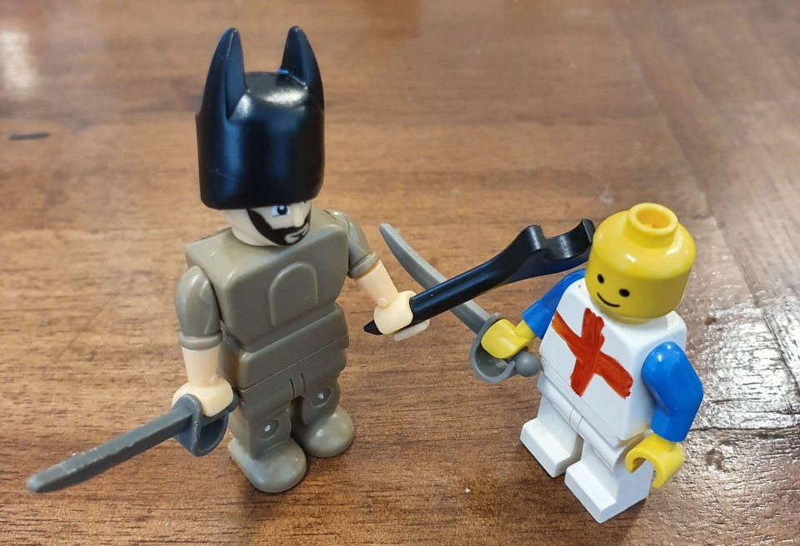

Slide 46
St George is slain!!

Slide 47
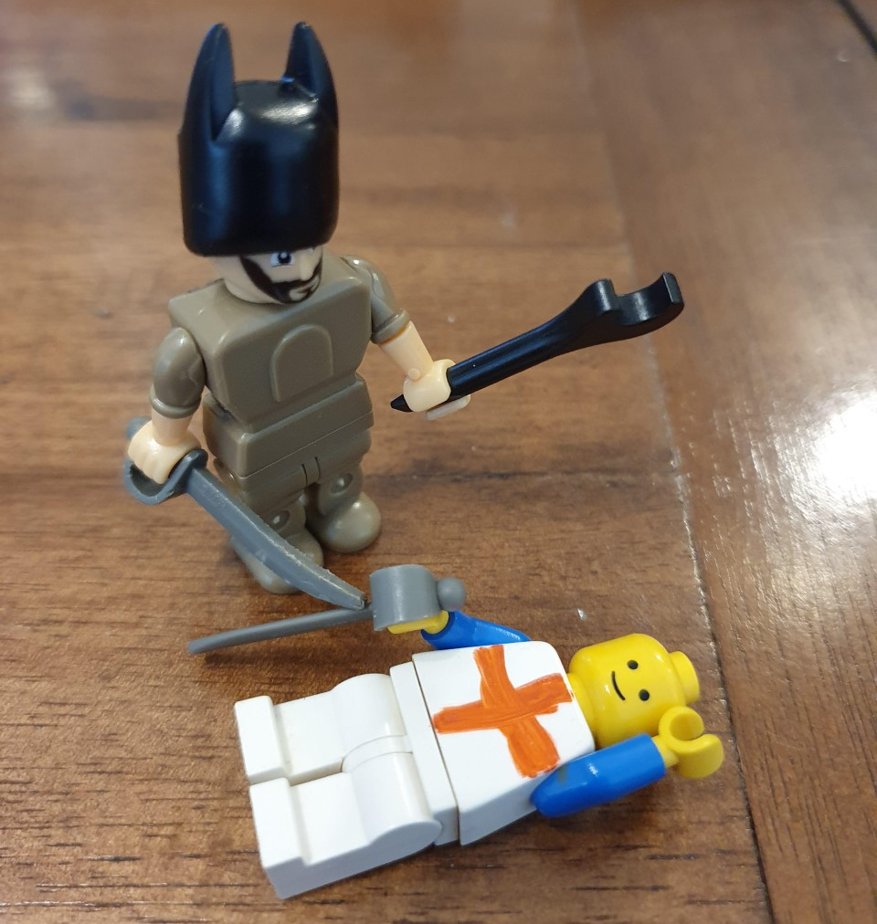

Slide 48
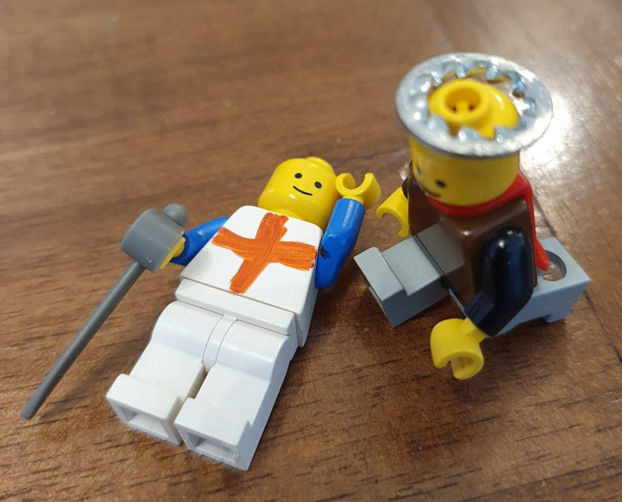
Oh horrible, terrible What hast thou done?

Slide 49
Oh horrible, terrible What hast thou done?
Thou haste ruined me, ruined me,
By the killing of my only son

Slide 50
Oh, is there a noble Doctor to be found?
To cure this English champion of his deep and deadly wound!

Slide 51
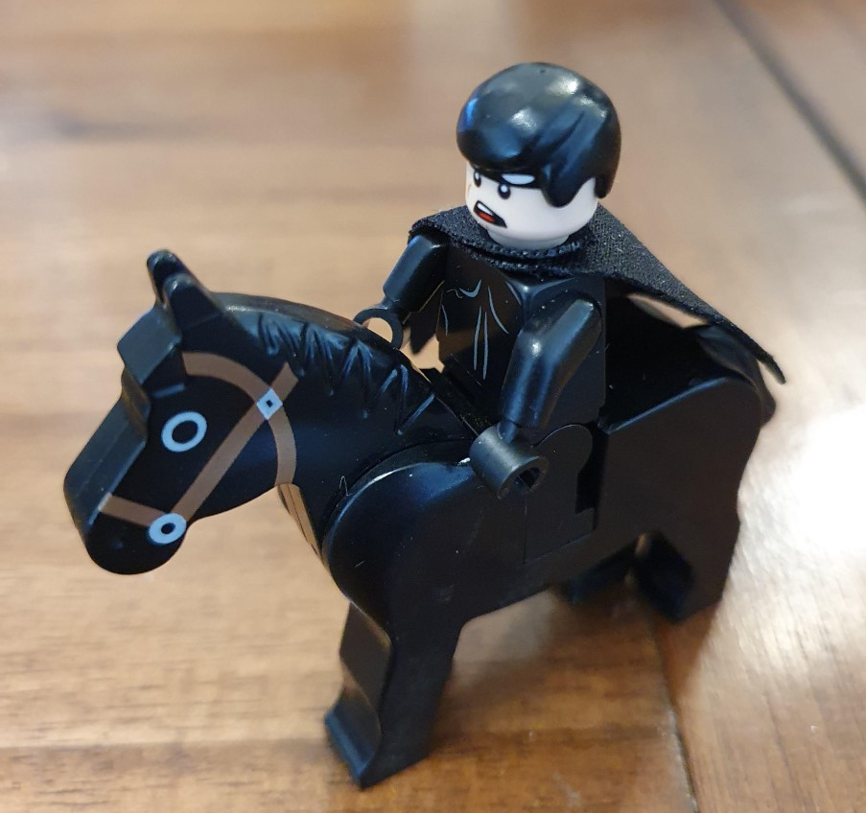
YES! there is a noble Doctor to be found?

Slide 52
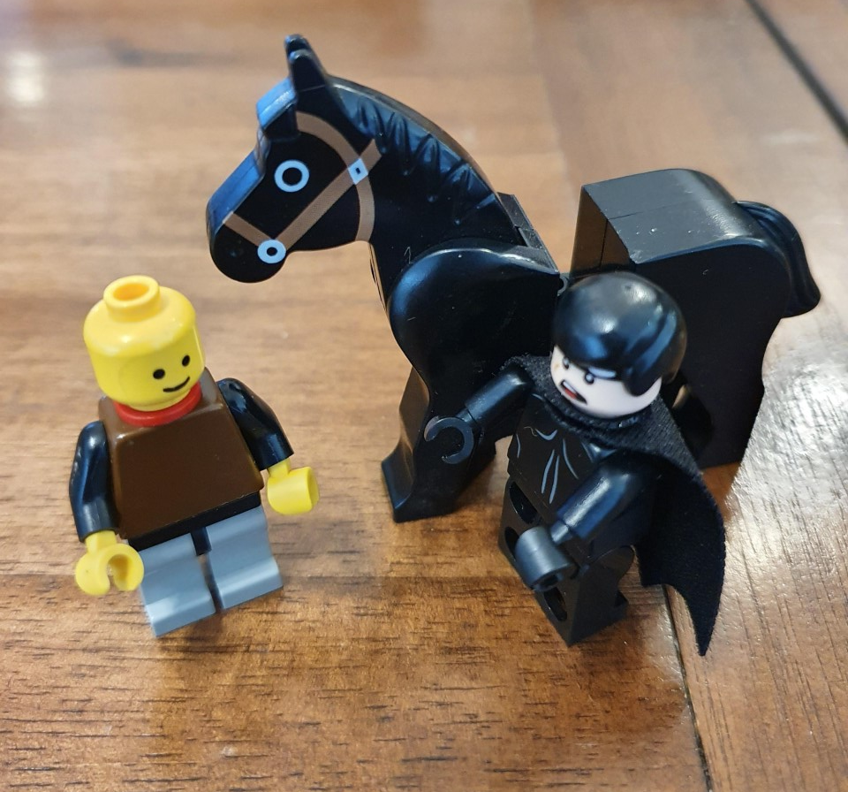
YES! there is a noble Doctor to be found?
To cure this English champion of his deep and deadly wound!

Slide 53
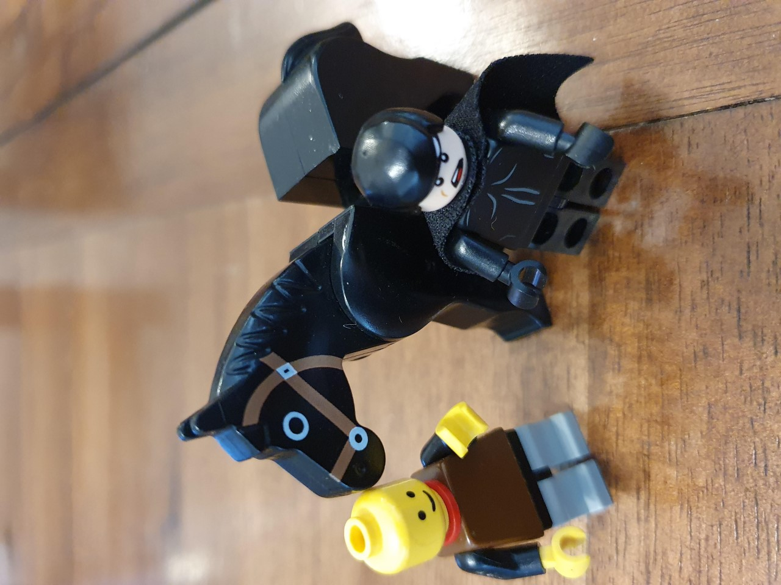
What is your practice?

Slide 54
I boast not of my practice,
Neither do I study in the practise of physic
I torture not my patients with excavations
Such as pills, boluses, solutions and embrocations
I’ve been to upper bendover, lower legover
Half way round the world and back again
My wisdom lies in my wig

Slide 55
I’ve been to Italy, Tittily,
Sicily, Cecily and Threcilly.
I’ve been to Tintwistle, Slaithwaite and Colmondely
And up my landlady’s vest
And once, I even went as far as Heywood!

Slide 56
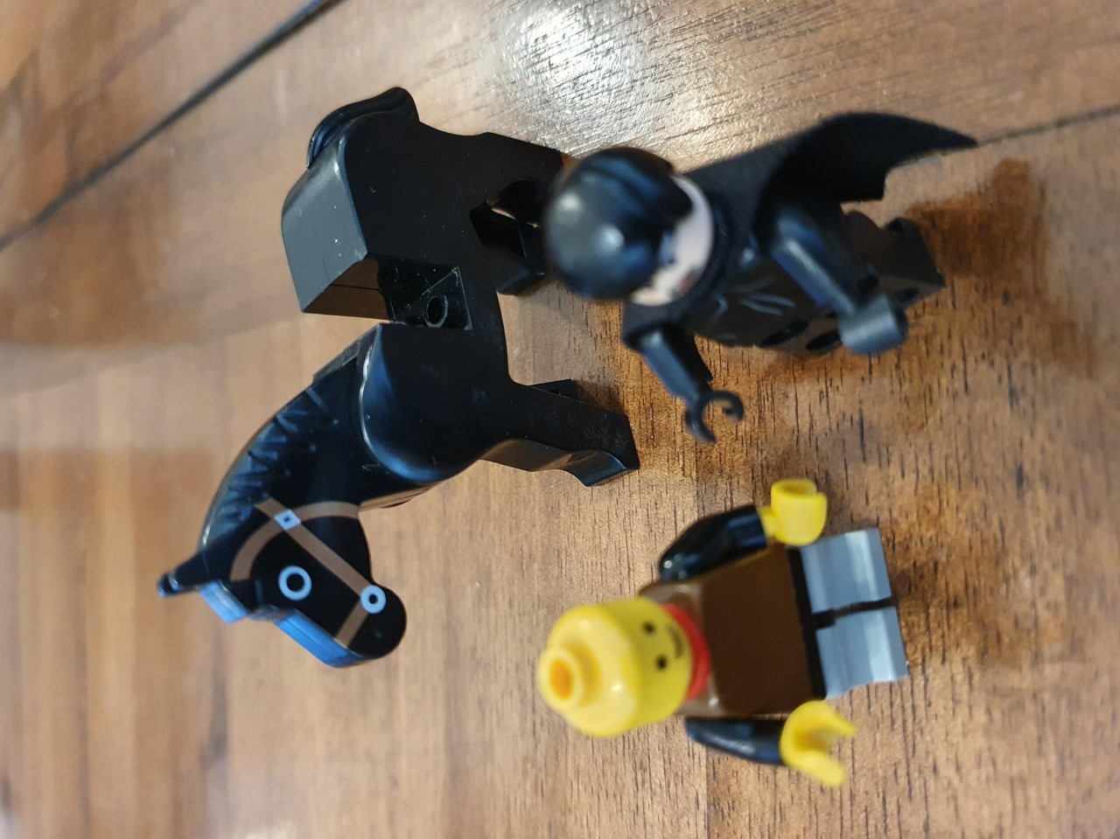
And what canst thou cure?

Slide 57
All kinds of diseases
Whatever you pleases
The itch, mitch, pitch, flitch and ditch
The otch, motch, potch, flotch and dotch
The pox, the palsy and the gout
And if the devil’s in a man, I’ll fetch six of the buggers out!

Slide 58
Pray, what is thy fee?

Slide 59
Pray, what is thy fee?
Ten pounds is true!

Slide 60
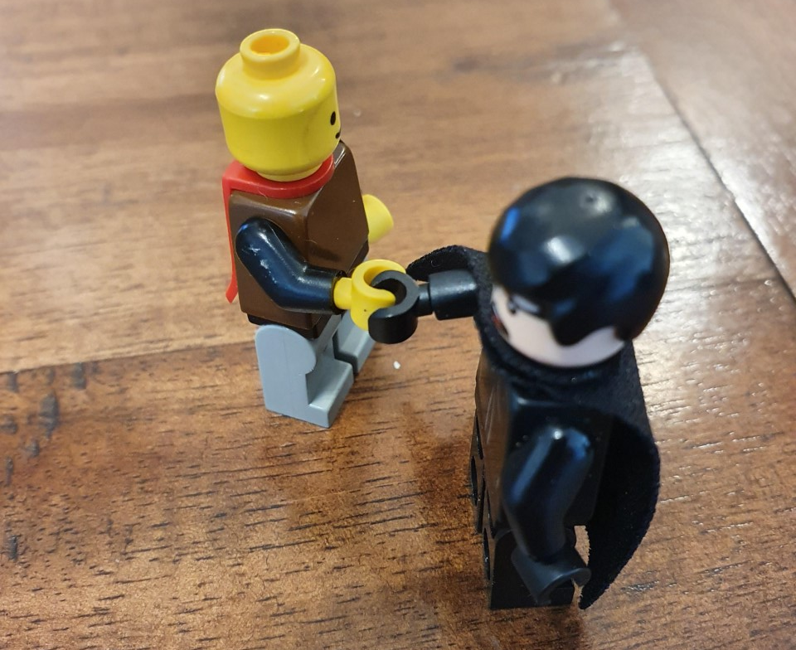
Pray, what is thy fee?
Ten pounds is true!
Proceed noble Doctor, thou shalt have thy due

Slide 61
In my bag I have crutches for lame hedgehoppers,
Glasses for blind mice

Slide 62
In my bag I have crutches for lame hedgehoppers,
Glasses for blind mice.
I have stuff to keep honeymoon couples on their honeymoon for 47 years
And make your shirt go up and down your back like a roller blind

Slide 63
After various ministrations, some of which are too gruesome to show here, the doctor concludes

Slide 64
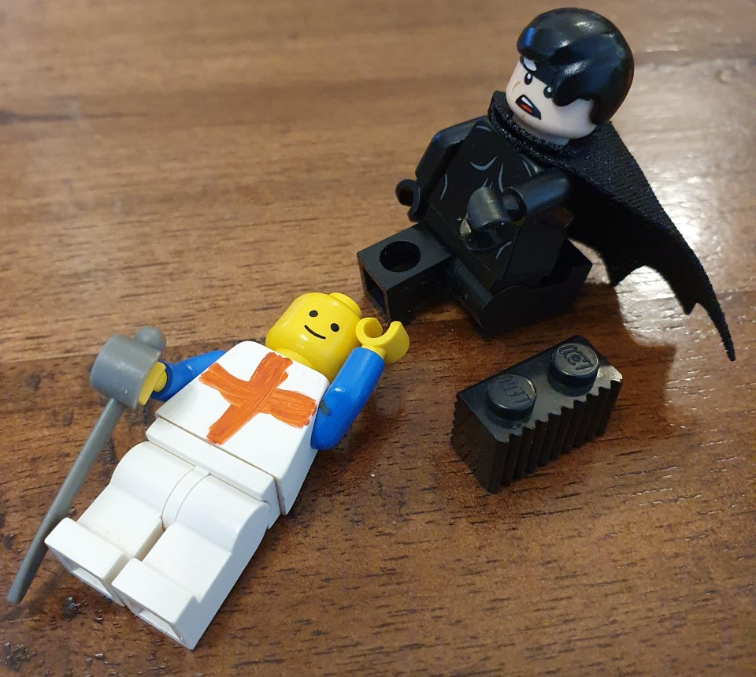
In my inside outside pocket I have a bottle of Alicapimpompane

Slide 65
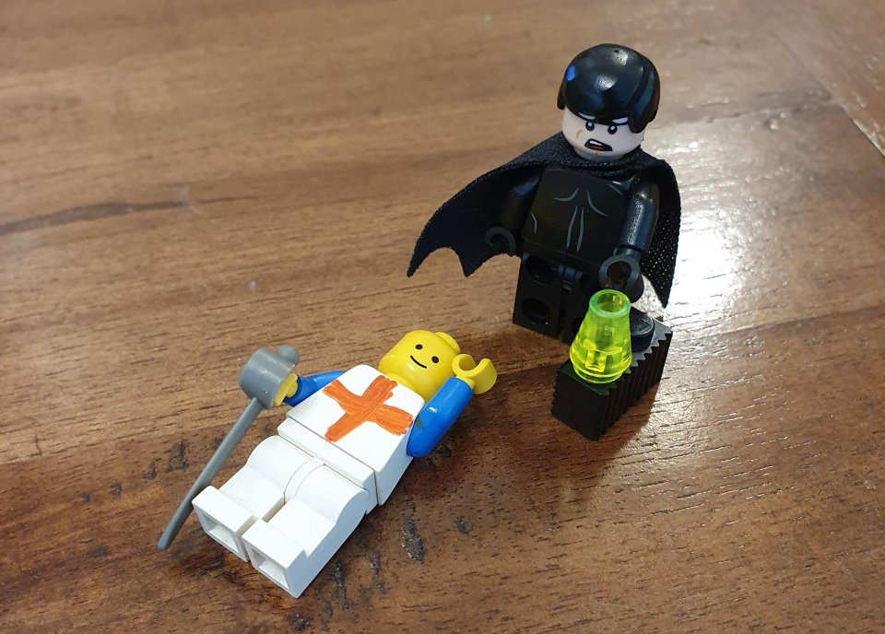
In my inside outside pocket I have a bottle of Alicapimpompane
Which brings the dead to life again

Slide 66
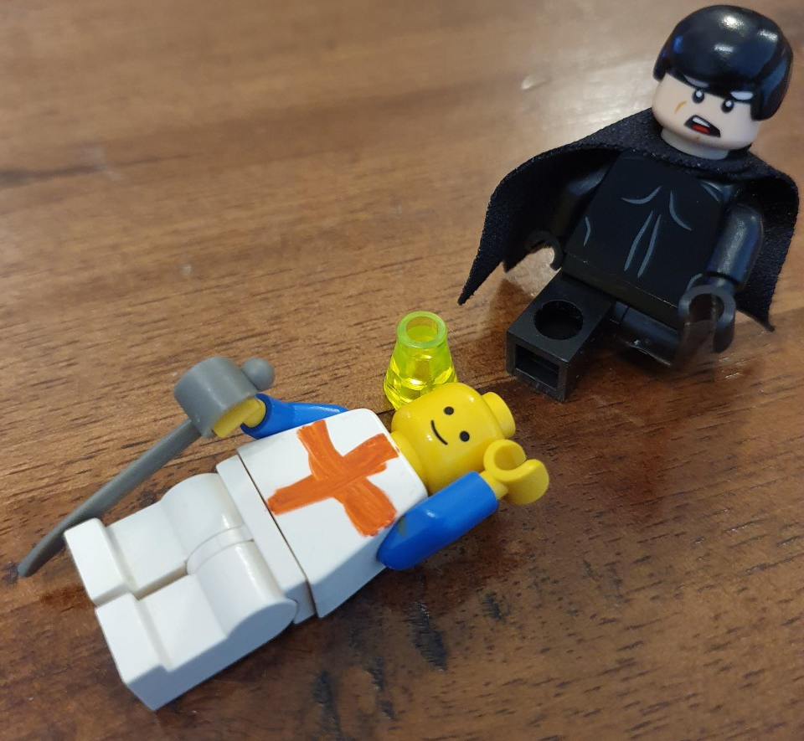
In my inside outside pocket I have a bottle of Alicapimpompane
Which brings the dead to life again
A drop on the head,

Slide 67
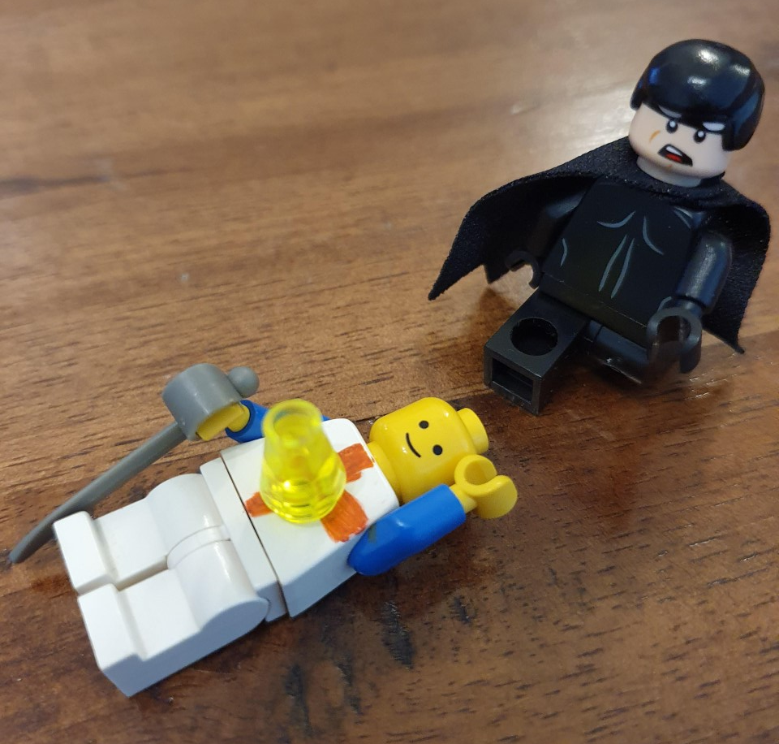
In my inside outside pocket I have a bottle of Alicapimpompane
Which brings the dead to life again
A drop on the head, a drop on the heart

Slide 68
In my inside outside pocket I have a bottle of Alicapimpompane
Which brings the dead to life again
A drop on the head, a drop on the heart
Rise up young man and take thy part

Slide 69
Arise, arise, most noble knight arise
And no more dormant lay

Slide 70
Arise, arise, most noble knight arise
And no more dormant lay
And with that sword that’s in your hand

Slide 71
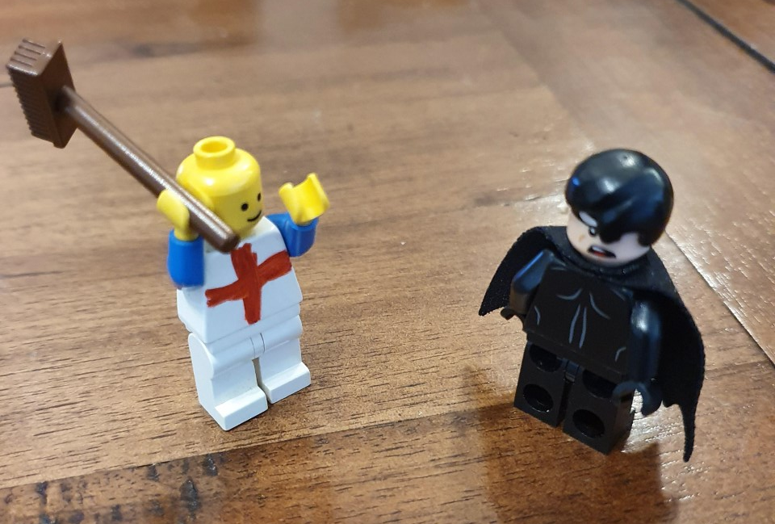
Arise, arise, most noble knight arise
And no more dormant lay
And with that sword that’s in your hand
Make all your foes obey!

Slide 72
My head is made of iron

Slide 73
My head is made of iron My body’s made of steel

Slide 74
My head is made of iron My body’s made of steel
My legs are made of crooked bones
To make you all to yield!

Slide 75
They fight!
The Turkish Champion is slain!!

Slide 76
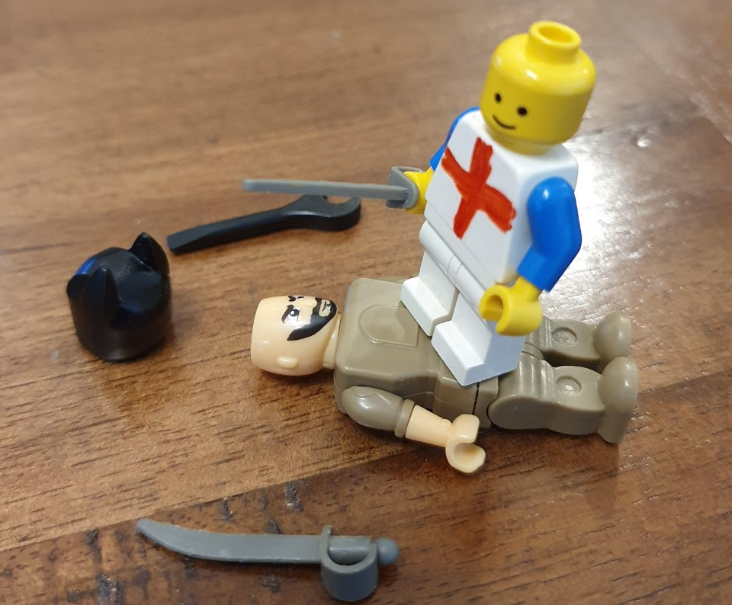

Slide 77
In comes I who’s never been yet With my big head and little wit

Slide 78
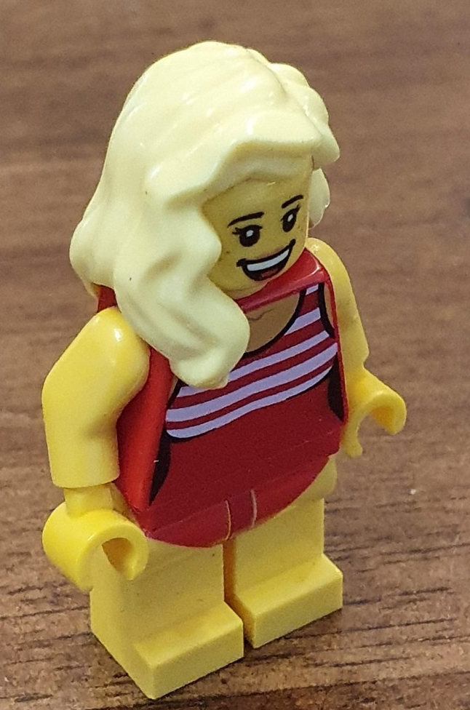
In comes I who’s never been yet With my big head and little wit
With my head so big and wit so small
I’ll do my best to please you all

Slide 79
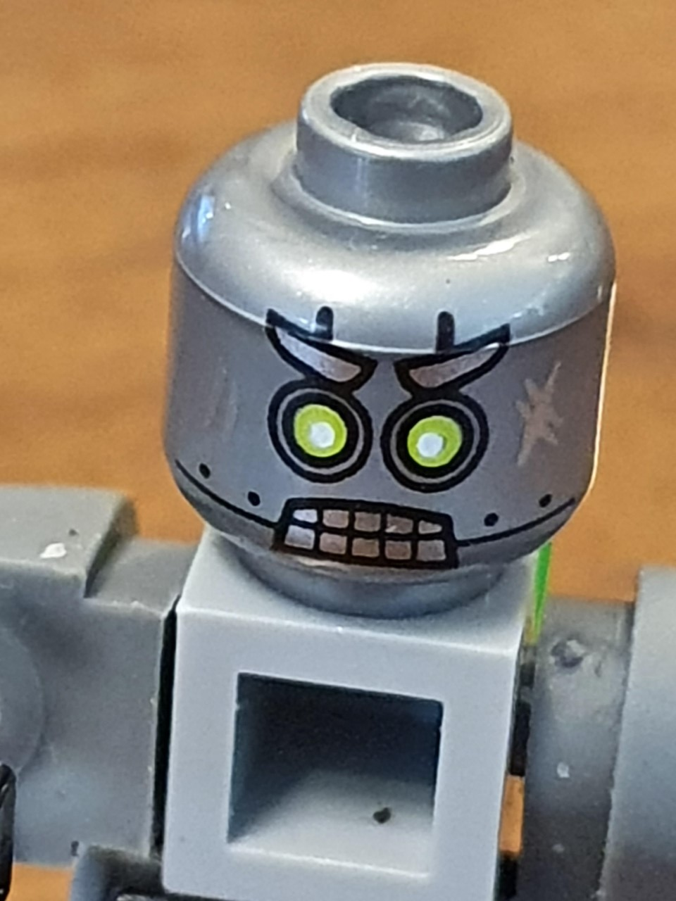
In comes I, old Beelzebub

Slide 80
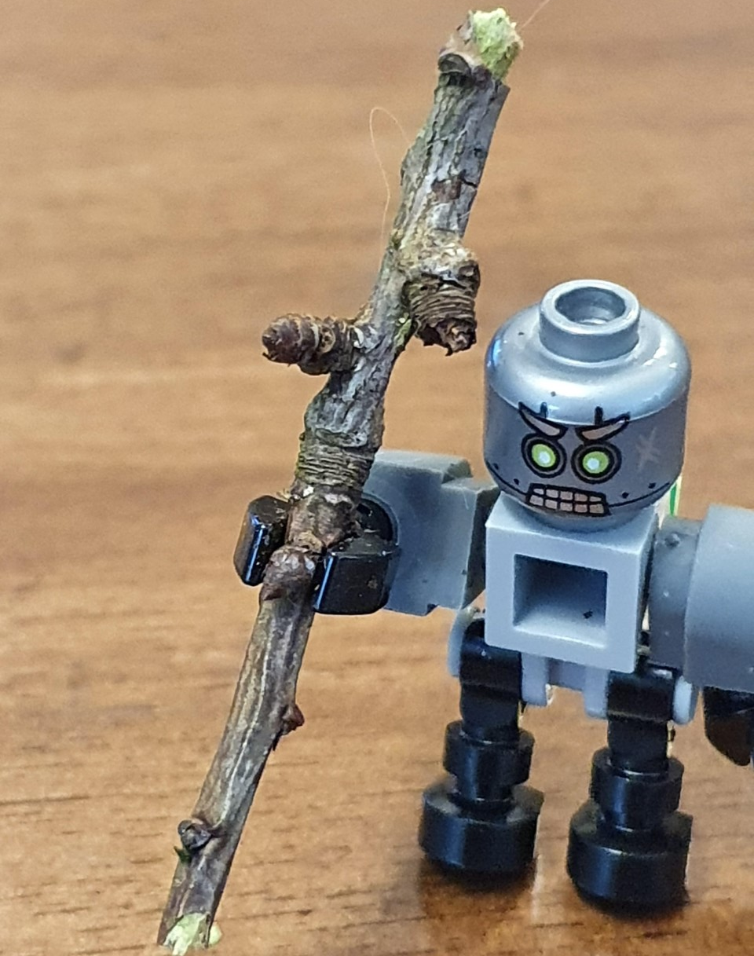
In comes I, old Beelzebub And over my shoulder I carry’s a club

Slide 81
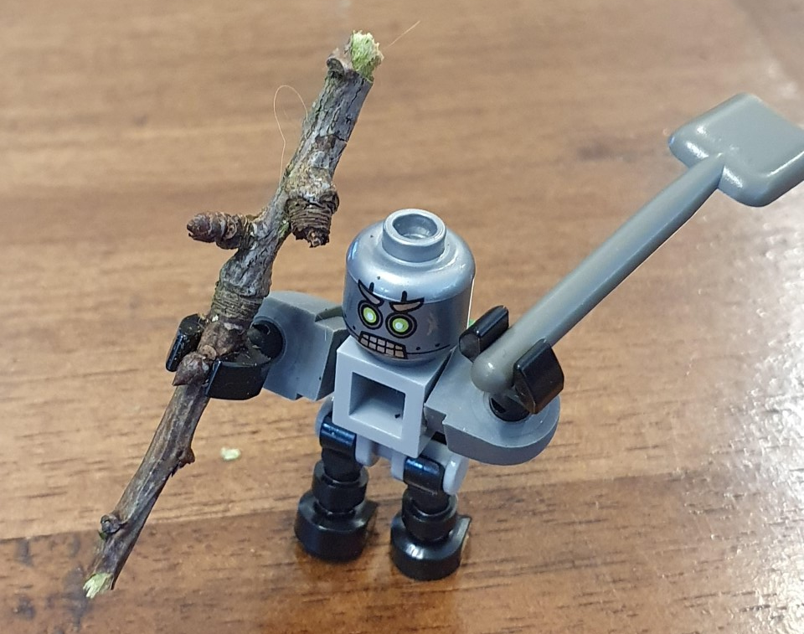
In comes I, old Beelzebub And over my shoulder I carry’s a club
And in my hand a frying pan

Slide 82
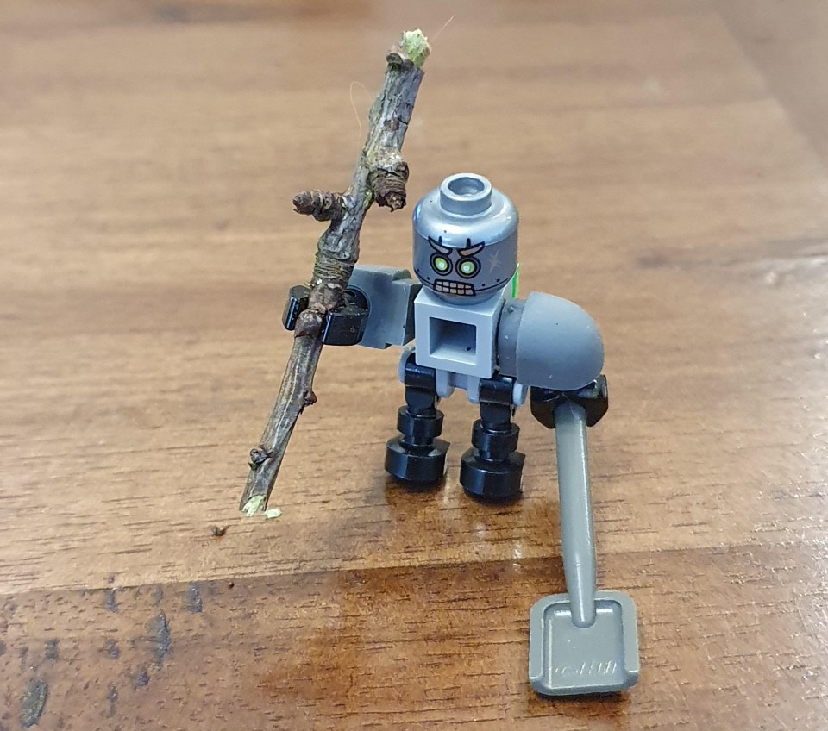
In comes I, old Beelzebub And over my shoulder I carry’s a club
And in my hand a frying pan
Pleased to collect all the brass that I can!

Slide 83
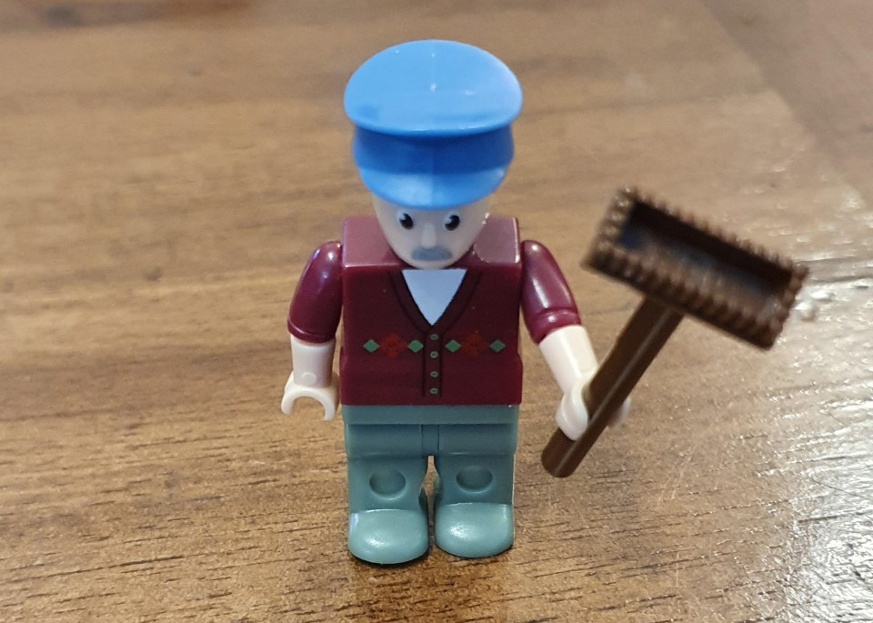
In comes I little Derry Doubt And with my brush I’ll sweep you all out

Slide 84
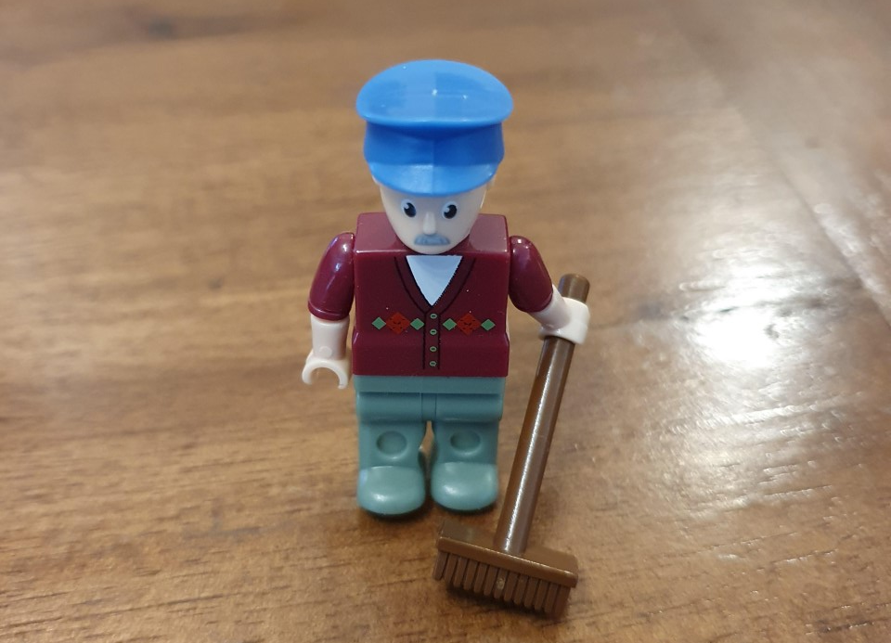
In comes I little Derry Doubt And with my brush I’ll sweep you all out
It’s money I want, and money I crave

Slide 85
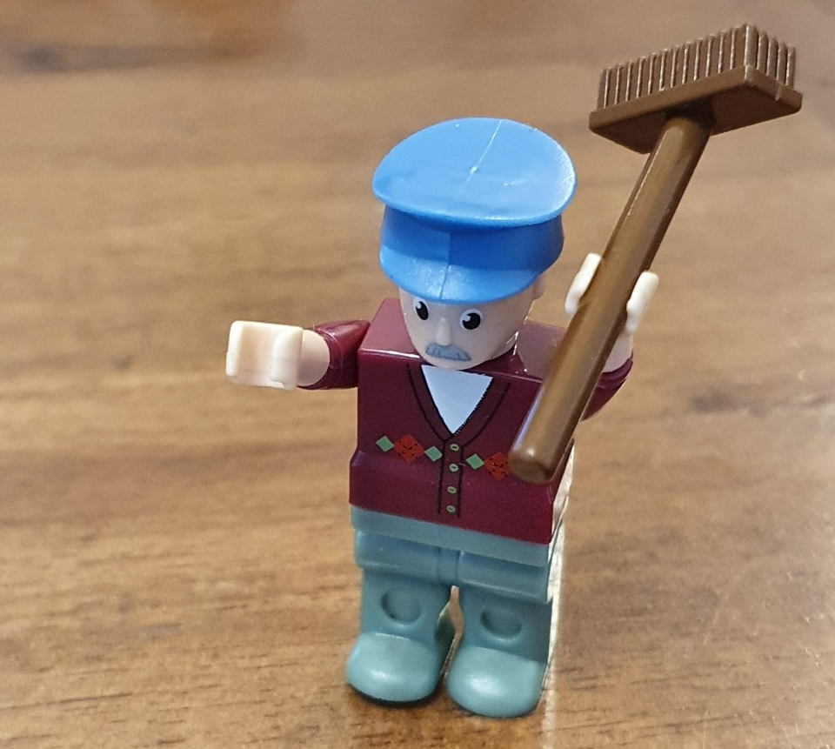
In comes I little Derry Doubt And with my brush I’ll sweep you all out
It’s money I want, and money I crave
If you don’t give me money I’ll sweep you all to the grave

Slide 86
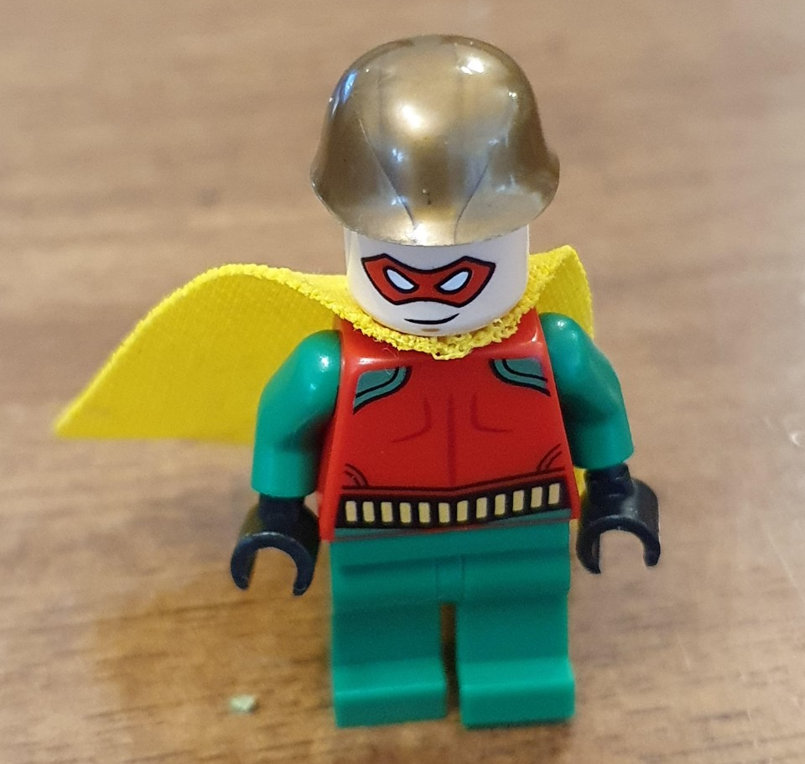
And in comes I Little Johnny Jack

Slide 87
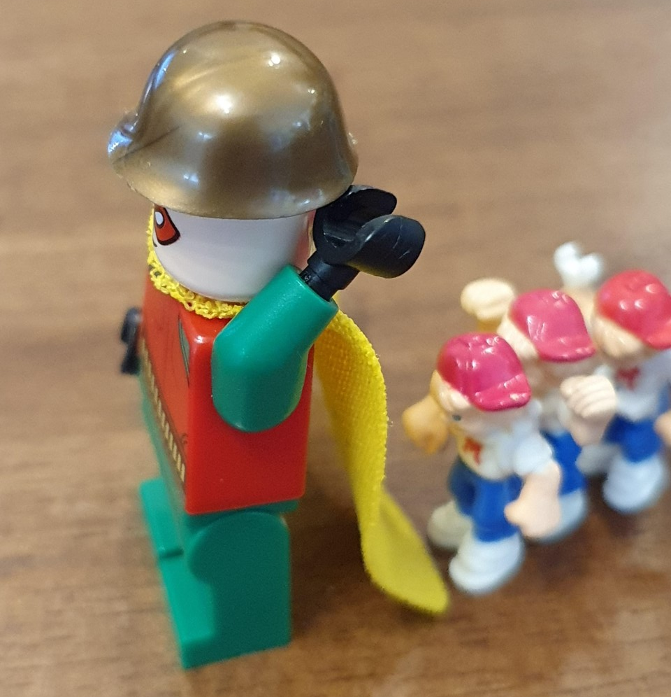
And in comes I Little Johnny Jack With all my children on my back

Slide 88
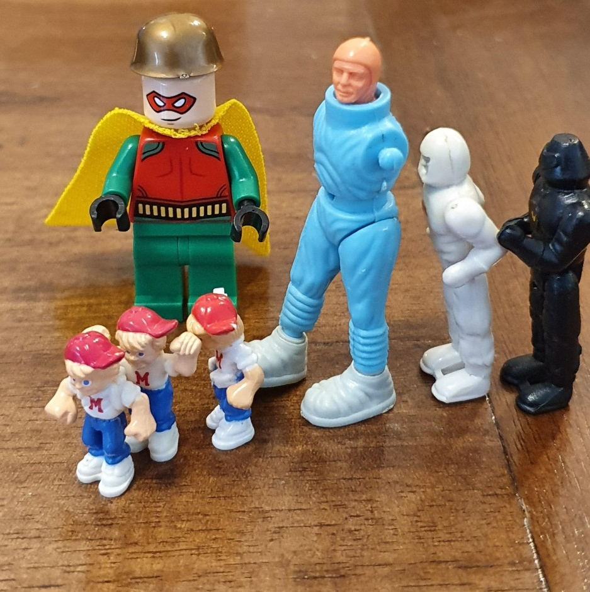
And in comes I Little Johnny Jack With all my children on my back
My family is large but I am small

Slide 89
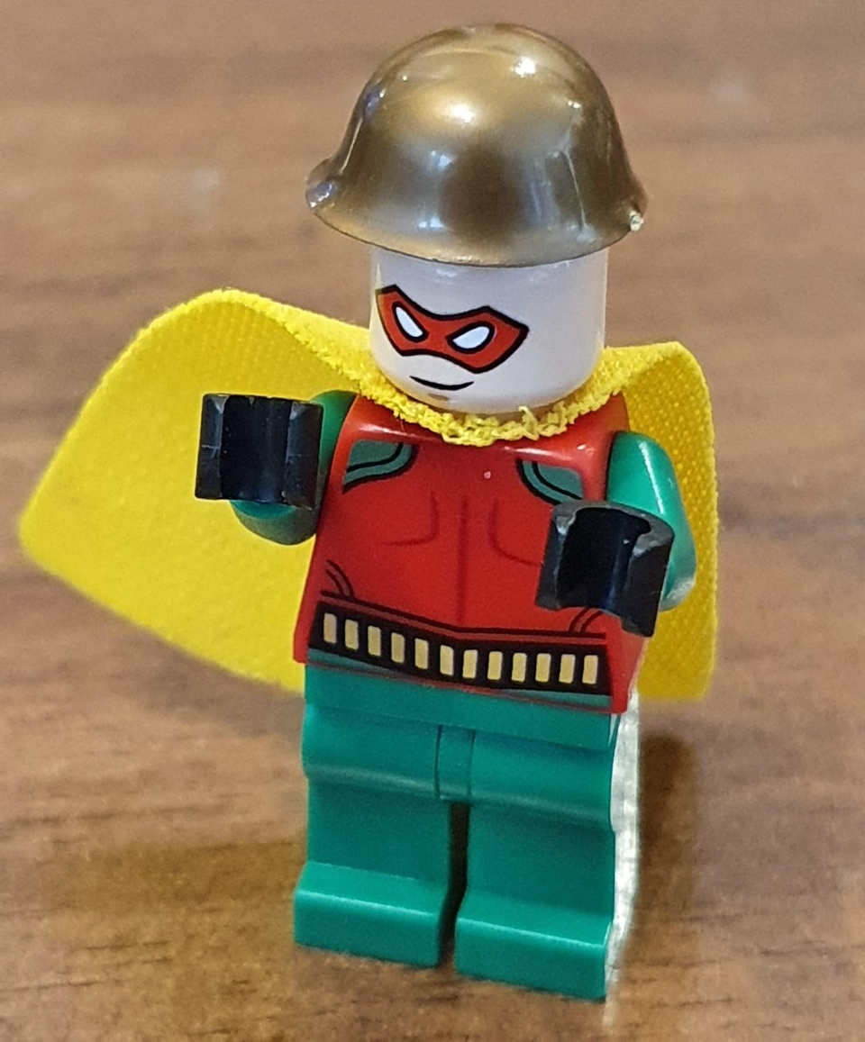
And in comes I Little Johnny Jack With all my children on my back
My family is large but I am small
A copper or two would help us all

Slide 90
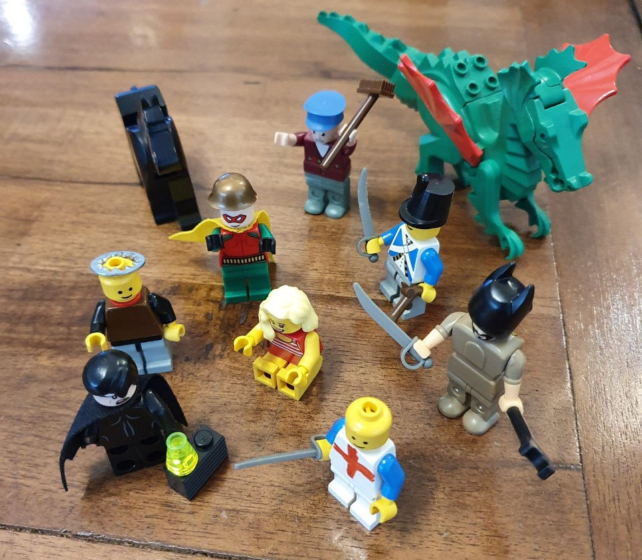
The performance ends with the singing of the final song

Slide 91
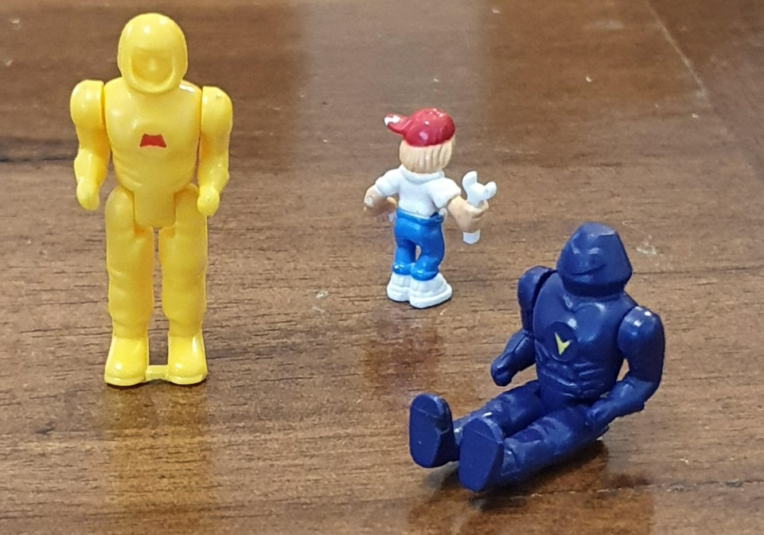
The performance ends with the singing of the final song
And the collection of donations from the massive crowd of onlookers

Slide 92
This year’s collection is in memory of Bob Ashworth
To donate to the work of ‘The Liver Nurses’ at Oldham General Hospital click or copy the link
https://www.justgiving.com/crowdfunding/martin-gittins?utm_term=76mw4nBzV

